Slide 1
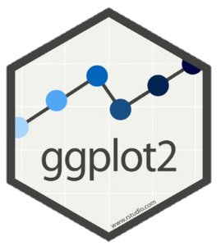
SNA using R 3 – Map SNA with ggplot
April 2019 – CDPH
Esther.Kukielka@CDPH.ca.gov
This workshop heavily borrows from the list of references provided at the end of the presentation

Slide 2
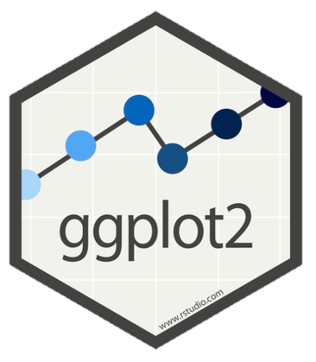
ggplot
One of the four main graphical systems available in r (base, grid, lattice, ggplot)
Created by Hadley Wickham, based on Leland Wilkinson’s Grammar of Graphics
Customized and easy to create graphs, but slower than base plot()
Plot = data + aesthetics + geometry + coordinates

Slide 3
ggplot
Plot = data + aesthetics + geometry + coordinates
Principal components of every plot (link):
Data (data) is a data frame.
Aesthetics (aes) is used to indicate x and y variables, as well as to control the color, the size or the shape of points, the height of bars, etc.
Geometry (geom_) defines the type of graphics (histogram, box plot, line plot, density plot, dot plot, …). Visual marks that represent data points.
Coordinates (coord_) determines how the x and y aesthetics combine to position elements in the plot.
There are two major functions in ggplot2 package: qplot() and ggplot() functions
qplot() stands for quick plot, which can be used to produce easily simple plots.
ggplot() function is more flexible than qplot for building a plot piece by piece.
Plot <⁻ ggplot (data , aes()) + geom_xxx() + coord_xxx()
Notes:
Coordinates is not unique of ggplot2! All plots in R have coordinates!

Slide 4
Chunk 1

Slide 5
Plotting networks
ggplot2()
ggplot package
GGally package::ggnet2()
geomnet package::geom_net(): Wraps all network structures, including vertices, edges, and vertex labels into a single geom
ggnetwork package:: geom_nodes() and geom_edges(): Implements each of the network structures in an independent geom and layers them one by one

Slide 6
Chunk 2

Slide 7
References
ggplot: http://www.sthda.com/english/wiki/ggplot2-essentials
Code for Tyner at al 2017
Vignette for ggnet2
Vignette for geomnet
Vignette for ggnetwork

